Slide 1




Learning How to Answer Multiple Choice Questions
Mastering test-taking strategies to empower Surgical Technology students for the CST exam.
Today we’re going to learn how to get better at answering multiple-choice questions effectively.
Chris Blevins, MBA, CST, FAST
,
Karen Chambers, MHA/Ed., CST, FAST

Slide 2






Why Multiple-
Choice Skills
Matter
Good Strategies Can improve Scores
MCQ’s Are Common In Quizzes,
Exams, And Standardized Tests
Understanding the impact of
strategy on student performance
and stress reduction.
Skills Reduce Stress And Save Time

Slide 3










Understand
the
Question
Identify what the question is really asking
Look for keywords (best, most likely, except, not)
Slowing down to ensure
total comprehension
before reviewing choices
Read the question carefully
Note: read the question before looking at the answer choices

Slide 4







Read All the
Answer Choices
Avoiding the trap of rushing to the first plausible answer
Compare all options
Don’t choose the first answer that looks correct
Watch out for answers that are only partially correct
Watch out for answers that are too extreme (always, never)

Slide 5


Eliminate Wrong Answers
Boosting your statistical odds by removing obvious errors
1
2
3
4
Cross out answers you know are incorrect
Narrow choices down to 2 if possible
Use logic and clues from the question
Note: Fewer choices increase your odds

Slide 6







Look
for Clues
in the
Question
Context Clues From Charts, Passages, Or Diagrams
Grammar Clues (singular Vs Plural)
Repeated Words From The Question
Extracting subtle hints
from context and
structure.

Slide 7




Watch for Common Traps
Navigating answers designed to divert the examinee.
Overthinking simple questions
All of the above options
None of the above options
Answers that sound correct but don’t fully answer the question

Slide 8



Smart Guessing Strategies
Applying logic when you aren't 100% sure of the answer.
Choose the most reasonable answer
Eliminate obvious wrong choices first
Note: Guessing after eliminating choices improves chances
Never leave an answer blank

Slide 9

Manage Your Time
Efficiency techniques to build confidence and prevent stalling.
Answer Easy Questions
Skip and Return
Limit Time Spent
Skip difficult questions and move on; return to them later if time allows.
Start with easier questions first to build confidence and momentum.
Don’t spend too long on any single hard question to avoid time drain.

Slide 10





Check Your Answers
Reviewing work
without falling
into the trap of
overthinking.
Change answers only if you find a clear mistake
Make sure you answered what was asked
Review if time allows

Slide 11








Practice Makes Progress
Building muscle memory for these strategies through repetition
Practice with sample questions
Use strategies consistently
Learn from mistakes

Slide 12





Key Takeaways
Let’s Put it All into Action
Consolidating core techniques for immediate application.
Eliminate wrong answers
Guess smart
Read carefully
Stay calm and confident
Use logic and clues

Slide 13


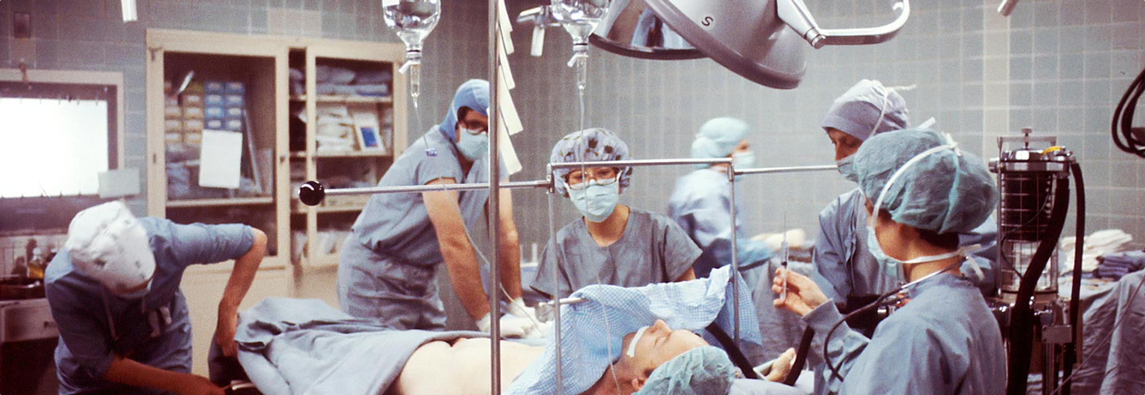
Wrapping it all UP – An Educator’s Role and Responsibility
Building student confidence and hard work toward CST success.
This test does not define who they are; but measures how hard they work!

